Slide 1
Prediction of responsive companies based on data consumer complaints
SankarNadendla
Sai Kiran Kuchupudi
Rishi Sai reddy Sudireddy

Slide 2
Index
•Introduction
•Data and attributes
•Related works
•Result
•Conclusion

Slide 3
Introduction
•There has been a huge explosion of financial institutions over decade offering various financial services. But not all companies provide all the products with equal quality and consumer responsiveness.
•Our financial institution has data analytics team which monitors the •Tools used are weka . It has lot more algorithms built in with advantage of pre-processing. Visualizations can be made .

Slide 4
Problem Description

Slide 5
Related works
•W. R. A. Fonseka et al., "Use of data warehousing to analyze customer complaint data of Consumer Financial Protection Bureau of United States of America," 2016 IEEE International Conference on Information and Automation for Sustainability (ICIAfS), Galle, 2016, pp. 1-6.
•Torben Hansen, Ricky Wilke, Judith Zaichkowsky, (2010) "Managing consumer complaints: differences and similarities among heterogeneous retailers", International Journal of Retail & Distribution Management, Vol. 38 Issue: 1, pp.6-23.
•There have been an influx of research papers on consumer data of late, but no particular research states explicitly the correlation between the consumer and the company’s service that the individual is trying to access.

Slide 6
Data and attributes
•We have collected this dataset from https://catalog.data.gov/dataset
•Total number of instances in this dataset was around 1 million
•following are the attributes included in dataset:
1.Date received 11. consumer complaint narrative
2.Product 12. company public response
3.Sub-product 13 company
4.Issue 14. state
5.Sub-issue 15. company response to consumer
6.zip code 16. timely response
7.Tags 17. consumer disputed
8.Consumer consent provided 18. complaint ID
9.Submitted via
10.Date sent to company

Slide 7
Data pre-processing
•We built our model with 7000 instances out of nearly 1 million instances.
•We have removed some unnecessary spaces between characters and special characters like “/”, “%”
•We have selected 5 attributes to describe the structural pattern in our data
1. Product
2. Company
3. Consumer disputed
4. Timely response
5. Company response to consumer

Slide 8
Algorithms
•We built our model with following data mining techniques:
1. classification
(A) naïve bayes
-Bagging
2. association rule mining
(A) apriori algorithm

Slide 9
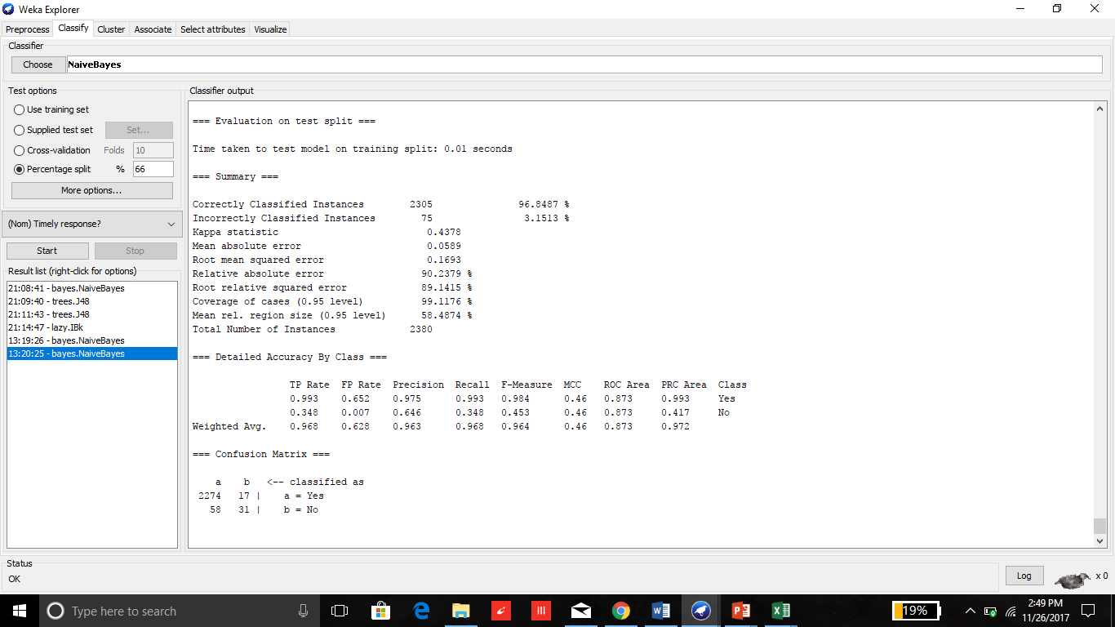

Slide 10
For the class ( timely response?), most of time companies response to complaint on-time.
Even though the companies have timely response towards a consumer record,there are some consumers who are disputed with company.
*(May be the response of the company is unsatisfactory)

Slide 11
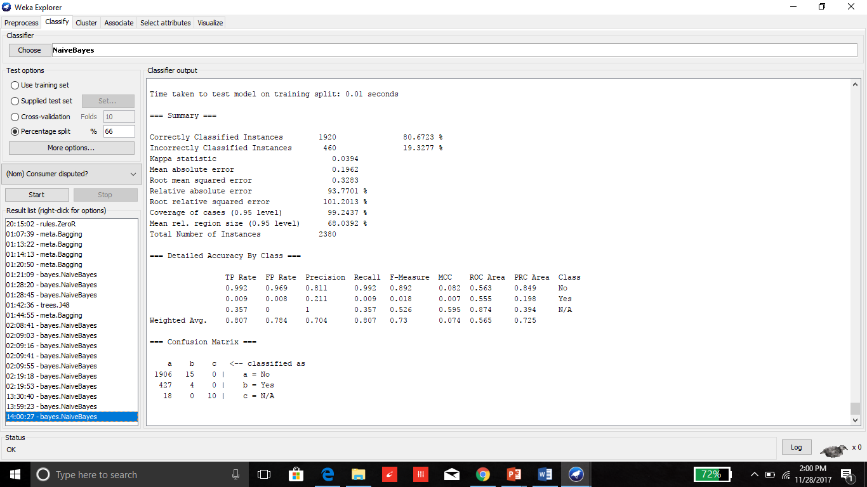

Slide 12
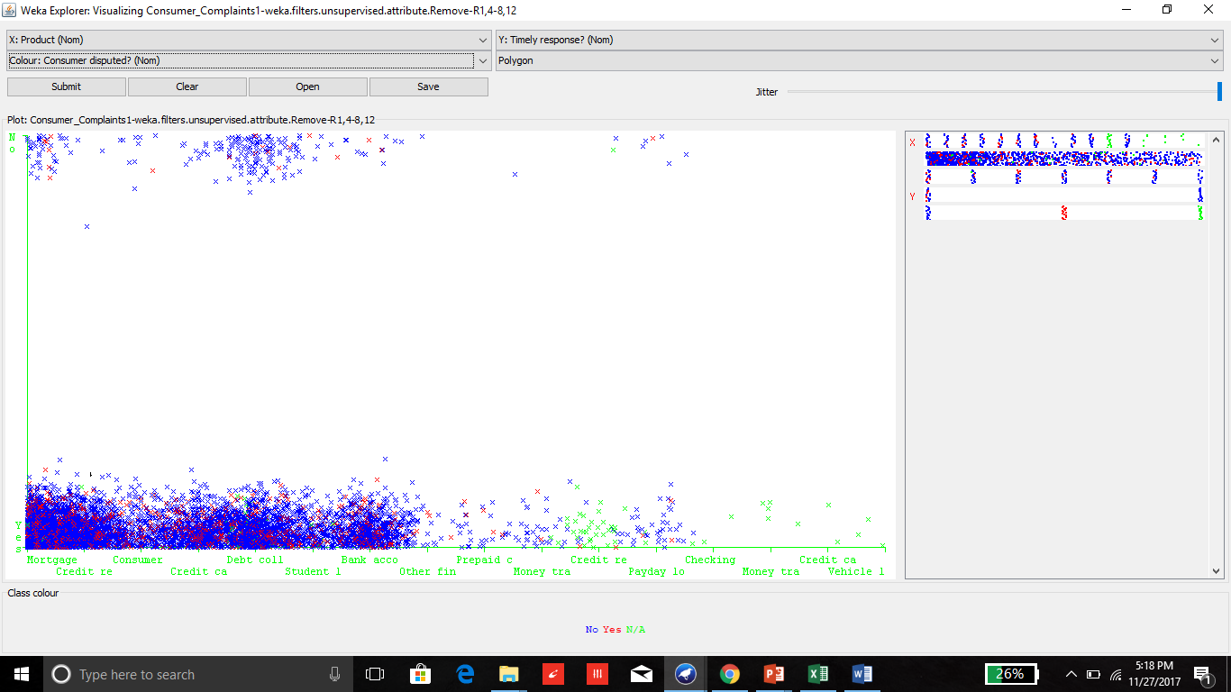

Slide 13
BAGGING

Slide 14
It is a simple and very powerful ensemble method. An ensemble method is a technique that combines the predictions from multiple machine learning algorithms together to make more accurate predictions than any individual model. Bagging is the application of the Bootstrap procedure to a high-variance machine learning algorithm, typically decision trees.

Slide 15
As we know, Bagging of different training sets decrease the overall error.
In case of our dataset, overall error increases by 0.0015.
Do bagging only work good with decision trees?
In our dataset most classes are with one value, learning type is stable therefore, there isn’t much difference in results.

Slide 16
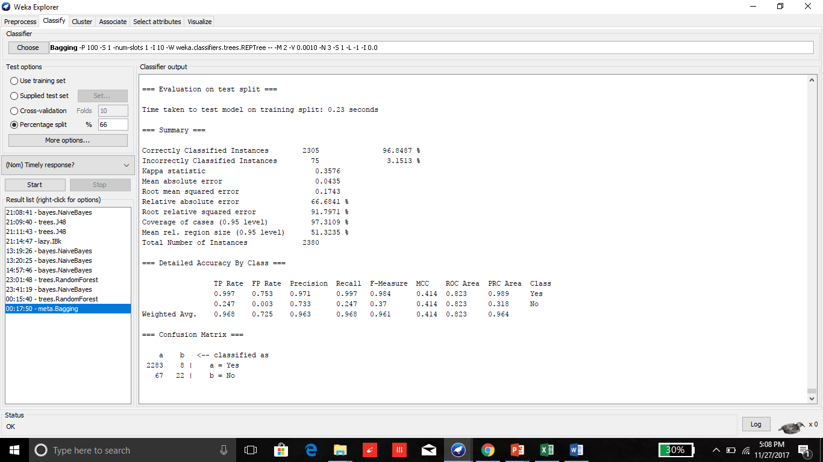

Slide 17
Apriori algorithm

Slide 18
In beginning, we look for the rules with minimum confidence of 0.9 and minimum support of 6 out of 100 instances.
As, our dataset have lot of distinct values for every attributes. Therefore, we got only few good result. However, this association rule was between only two attributes.
Company=Experian Information Solutions Inc. 430 ==> Timely response?=Yes 430 <conf:(1)> lift:(1.03) lev:(0) [13] conv:(13.95)
Product=Mortgage Consumer disputed?=Yes 439 ==> Timely response?=Yes 433 <conf:(0.99)> lift:(1.02) lev:(0) [8] conv:(2.03)
Upper-bound support | Lower-bound support | confidence
0.1 | 0.06 | 0.9

Slide 19
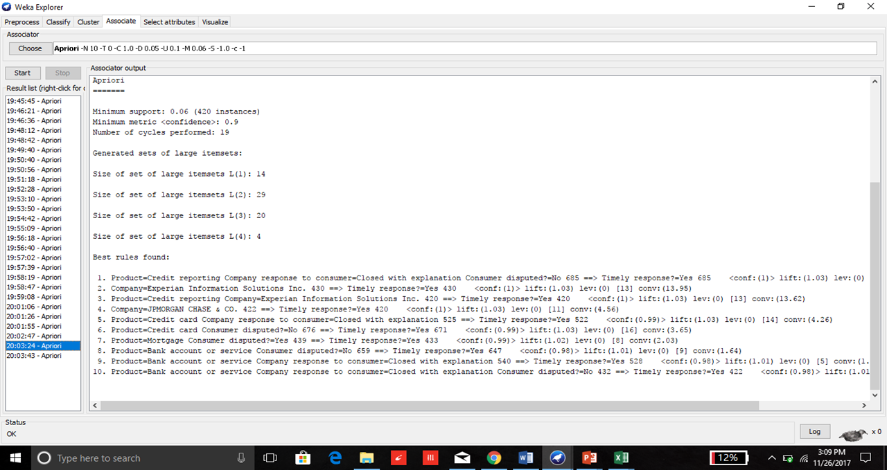

Slide 20
When we changed some of the parameters and decrease the upper bound support to 0.009 and confidence 1.0
We find the many interesting and good rules with large item-set up to five attributes.
We come to know, even which company disputed the consumer most and with which product issue.
Lower-bound support | Upper-bound support | confidence
0.001 | 0.009 | 1.0

Slide 21
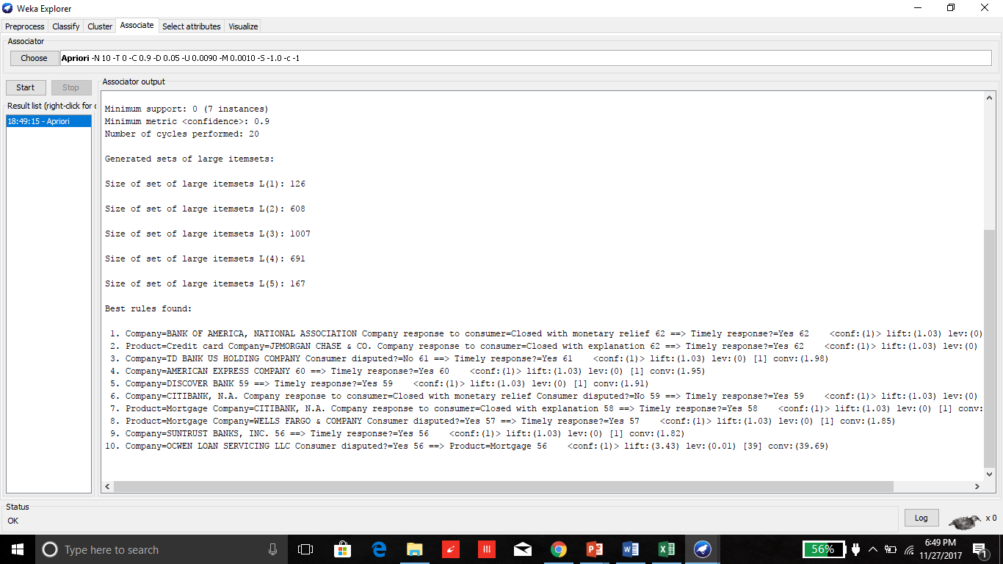

Slide 22
Conclusion
• In most of the cases, financial services companies respond timely to consumer complaints and consumer are not disputed
• From association rule mining, we come to know about:
1. “Experian Information Solutions Inc.” is the best responsive company to
consumer complaints.
2. Product “ credit reporting” get the most timely response.
3. Most of the consumers disputed in the case of “ mortgage” .
4. “Wells fargo inc. “ disputed consumers most of time.
ed

